Slide 1
Measures of Position
The z-Score
Percentiles
Deciles and Quartiles
The Box Plot
13-4-<number>
© 2008 Pearson Addison-Wesley. All rights reserved

Slide 2
Measures of Position
In some cases we are interested in certain individual items in the data set, rather than in the set as a whole. We need a way of measuring how an item fits into the collection, how it compares to other items in the collection, or even how it compares to another item in another collection. There are several common ways of creating such measures and they are usually called measures of position.
13-4-<number>
© 2008 Pearson Addison-Wesley. All rights reserved

Slide 3

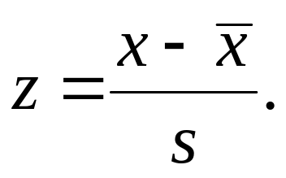
The z-Score
If x is a data item in a sample with mean and standard deviation s, then the z-score of x is given by
13-4-<number>
© 2008 Pearson Addison-Wesley. All rights reserved

Slide 4
Example: Comparing with z-Scores
Two students, who take different history classes, had exams on the same day. Jen’s score was 83 while Joy’s score was 78. Which student did relatively better, given the class data shown below?
 | Jen | Joy
Class mean | 78 | 70
Class standard deviation | 4 | 5
13-4-<number>
© 2008 Pearson Addison-Wesley. All rights reserved

Slide 5
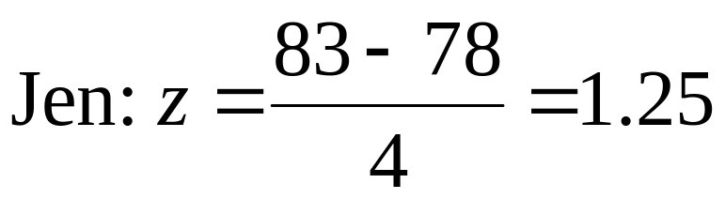
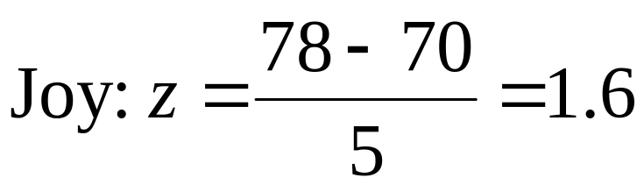
Example: Comparing with z-Scores
Solution
Calculate the z-scores:
Since Joy’s z-score is higher, she was positioned relatively higher within her class than Jen was within her class.
13-4-<number>
© 2008 Pearson Addison-Wesley. All rights reserved

Slide 6
Percentiles
When you take a standardized test taken by larger numbers of students, your raw score is usually converted to a percentile score, which is defined on the next slide.
13-4-<number>
© 2008 Pearson Addison-Wesley. All rights reserved

Slide 7
Percentiles
If approximately n percent of the items in a distribution are less than the number x, then x is the nth percentile of the distribution, denoted P_{n}.
13-4-<number>
© 2008 Pearson Addison-Wesley. All rights reserved

Slide 8
Example: Percentiles
The following are test scores (out of 100) for a particular math class.
44 56 58 62 64 64 70 72
72 72 74 74 75 78 78 79
80 82 82 84 86 87 88 90
92 95 96 96 98 100
Find the fortieth percentile.
13-4-<number>
© 2008 Pearson Addison-Wesley. All rights reserved

Slide 9
Example: Percentiles
Solution
The 40th percentile can be taken as the item below which 40 percent of the items are ranked. Since 40 percent of 30 is (.40)(30) = 12, we take the thirteenth item, or 75, as the fortieth percentile.
13-4-<number>
© 2008 Pearson Addison-Wesley. All rights reserved

Slide 10
Deciles and Quartiles
Deciles are the nine values (denoted D₁, D₂,…, D₉) along the scale that divide a data set into ten (approximately) equal parts, and quartiles are the three values (Q₁, Q₂, Q₃) that divide the data set into four (approximately) equal parts.
13-4-<number>
© 2008 Pearson Addison-Wesley. All rights reserved

Slide 11
Example: Deciles
The following are test scores (out of 100) for a particular math class.
44 56 58 62 64 64 70 72
72 72 74 74 75 78 78 79
80 82 82 84 86 87 88 90
92 95 96 96 98 100
Find the sixth decile.
13-4-<number>
© 2008 Pearson Addison-Wesley. All rights reserved

Slide 12
Example: Percentiles
Solution
The sixth decile is the 60th percentile. Since 60 percent of 30 is (.60)(30) = 18, we take the nineteenth item, or 82, as the sixth decile.
13-4-<number>
© 2008 Pearson Addison-Wesley. All rights reserved

Slide 13
Finding Quartiles
For any set of data (ranked in order from least to greatest):
The second quartile, Q₂, is just the median.
The first quartile, Q₁, is the median of all items below Q₂.
The third quartile, Q₃, is the median of all items above Q₂.
13-4-<number>
© 2008 Pearson Addison-Wesley. All rights reserved

Slide 14
Example: Quartiles
The following are test scores (out of 100) for a particular math class.
44 56 58 62 64 64 70 72
72 72 74 74 75 78 78 79
80 82 82 84 86 87 88 90
92 95 96 96 98 100
Find the three quartiles.
13-4-<number>
© 2008 Pearson Addison-Wesley. All rights reserved

Slide 15
Example: Percentiles
Solution
The two middle numbers are 78 and 79 so
Q₂ = (78 + 79)/2 = 78.5.
There are 15 numbers above and 15 numbers below Q₂, the middle number for the lower group is
Q₁ = 72, and for the upper group is
Q₃ = 88.
13-4-<number>
© 2008 Pearson Addison-Wesley. All rights reserved

Slide 16
The Box Plot
A box plot, or box-and-whisker plot, involves the median (a measure of central tendency), the range (a measure of dispersion), and the first and third quartiles (measures of position), all incorporated into a simple visual display.
13-4-<number>
© 2008 Pearson Addison-Wesley. All rights reserved

Slide 17
The Box Plot
For a given set of data, a box plot (or box-and-whisker plot) consists of a rectangular box positioned above a numerical scale, extending from Q₁ to Q₃, with the value of Q₂ (the median) indicated within the box, and with “whiskers” (line segments) extending to the left and right from the box out to the minimum and maximum data items.
13-4-<number>
© 2008 Pearson Addison-Wesley. All rights reserved

Slide 18
Example:
Construct a box plot for the weekly study times data shown below.
1 | 5 8
2 | 0 7 8 9 9
3 | 2 6 6 7
4 | 0 2 2 7 9
5 6 | 1 5 6 6
13-4-<number>
© 2008 Pearson Addison-Wesley. All rights reserved

Slide 19
Example:
Solution
The minimum and maximum items are 15 and 66.
15
28.5
36.5
48
66
Q₁
Q₂
Q₃
13-4-<number>
© 2008 Pearson Addison-Wesley. All rights reserved

